Slide 1
UFCFB6-30-2 Object-oriented Systems Development
Unit 1 Introduction
Benedict R. Gaster
2016-17

Slide 2
Outline
Staff
Learning outcomes
Delivery
Assessment
Tools
Books
Taster of OO analysis and design
Java revision
ArrayList and HashMap

Slide 3
Staff contact
Dr. Benedict R. Gaster
Module Leader
2Q17
benedict.gaster@uwe.ac.uk
Tutors
Dr. Kun Wei
3Q42
Kun.wei@uwe.ac.uk
David Wyatt
David2.Wyatt@uwe.ac.uk
James Lear
James.Lear@uwe.ac.uk

Slide 4
Learning Outcomes of the Module
Describe the theory and concepts of the object-oriented paradigm
Explain the essential characteristics of the object-oriented software systems development lifecycle, including testing
Apply object-oriented analysis and design techniques for a number of problem domains scoped at level 2 complexity
Understand and use a Unified Modelling Language (UML) modelling tool and a Java-based Interactive Development Environment (IDE) to develop object-oriented software implementations appropriate to level 2 complexity
At an introductory level, apply object-oriented software patterns and architectures for increasingly large scale distributed software systems
Use an appropriate development environment to design and implement persistence within a distributed architecture at an introductory level.
Design and implement concurrent systems and distributed systems
Design and implement Graphical User Interfaces (GUIs)

Slide 5
Delivery
Lectures
Benedict Gaster
1 hour
Practicals
James Lear, David Wyatt, and Kun Wei
2 hours per week
Blackboard:
Lecture slides
Notes for practical sessions
Assignments and
General announcements

Slide 6
Assessments
Exam at the end of the module 50%
One assignment 50%,
individual assignment
requiring a number of staged hand-in, each hand-in is marked,
face-to-face marking and feedback with a provisional mark
final submission of the whole assignment, and an in-class demo

Slide 7
Tools
For design: We use a UML modelling tool by Astah
http://astah.net/download
For the PCs in the Labs, we have the Astah Professional version. If you want to install at home or your own laptops, Astah professional is free for students. However, for this module, the Community version is sufficient.
For Java programming, NetBeans http://www.netbeans.org/

Slide 8



Books
UML distilled: a brief guide to the standard object modelling language, Martin Fowler
Learning UML 2.0 A Pragmatic Introduction to UML, Russ Miles, Kim Hamilton
Head First Design Patterns
By Eric Freeman, Elisabeth Robson, Bert Bates, Kathy Sierra
For Java, use the book you used in your first year or any Java book.

Slide 9
Differences between Year 1 and Year 2
Year 1:
Focused on programming
Structural design solutions were given
Introduced simple UML modelling of the class concepts
Year 2:
Larger scale of applications
Need to identify suitable classes
More emphasis on the design and the rationales of your design decisions.

Slide 10
Example from year 1
Holiday class ==================== - cost : int - destination : String ================================= + Holiday ( ) + Holiday (int cost, String destination) + getCost( ) : int + getDestination( ) : int + setCost(int cost) : void + setDestination(String destination) : void + costPerDay( ) : int
Implement in Java

Slide 11
A taster of the design
Case Study UweFlix.doc
Produce a software design using UML to capture
The requirements
The structure of the system
The dynamic behaviour of the system
Implement it using Java

Slide 12
Understand the requirements of UweFlix
(Focusing on functional requirements only)
Who will be using or interacting with this system?
What interactions do the users want to have with the system?
We will use UML’s Use Case Diagram, together with use case descriptions.

Slide 13
Explore the requirement of UweFlix
Purchase adv ticket
Add film
Customer
Cinema mgr
UweFlix system

Slide 14
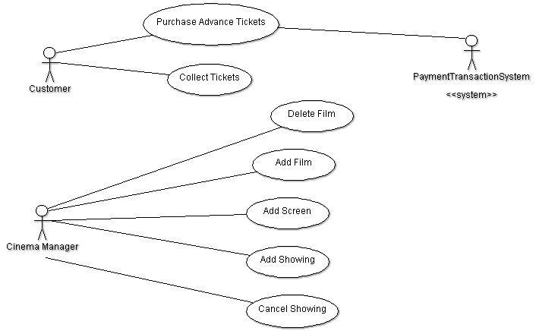
Capture the requirements using Use case diagram

Slide 15
Think about the structure of the UweFlix system
Once we know who will use the system and what interactions they want, we now need to think about how to structure the system
What classes, how they relate with each other
We will use UML’s class diagram to do this.

Slide 16
What classes are inside UweFlix
Film
Purchase adv ticket
Showing
Screen
Add film
Booking
UweFlix system

Slide 17
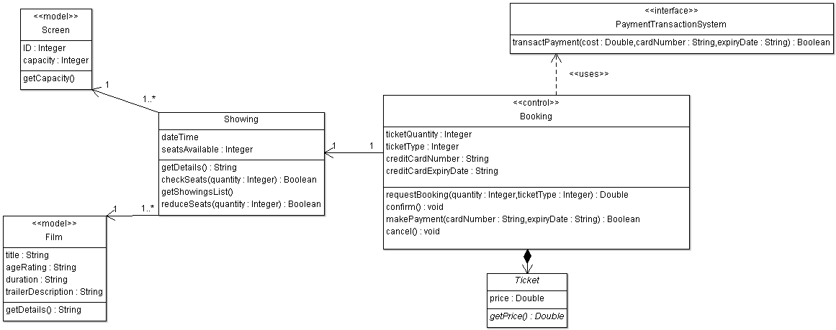
Capture the structure using UML Class diagram

Slide 18
What is the dynamic behaviour of UweFlix
The class diagram only describes the static structure of how the system is decomposed into what components.
It does not tell us how these components can communicate with each other in order to produce the result required from a user.
We will use one of the UML’s sequence diagrams

Slide 19
How the components communicate with each other inside UweFlix
Film
3
Purchase adv ticket
4
Showing
Screen
2
Add film
1
Booking
UweFlix system

Slide 20
Capture the dynamic behaviour using the Sequence diagram

Slide 21
From design to implementation
Similar to year 1, but bigger scale and more complicated class relationships.
Each class in the class diagram is implemented as a class in Java program.
All methods in each class in the class diagram must be implemented.
If a method needs to call another object in order to complete its task, the call relationship must implement the relationship captured in the sequence diagram.

Slide 22
Java revision
Sample questions from year 1 exam:

Slide 23
ArrayList Revision –what is the output?
public static void main(String args[]) {
ArrayList al = new ArrayList();
System.out.println("Initial size of al: " + al.size());
// add elements to the array list
al.add("C");
al.add("A");
al.add("E");
al.add(1, "A2");
System.out.println("Size of al after additions: " + al.size());
System.out.println("Contents of al: " + al);
// Remove elements from the array list
al.remove("A");
al.remove(2);
System.out.println("Size of al after deletions: " + al.size());
System.out.println("Contents of al: " + al);
}}

Slide 24
The output:
Initial size of al: 0
Size of al after additions: 4
Contents of al: [C, A2, A, E]
Size of al after deletions: 2
Contents of al: [C, A2]

Slide 25
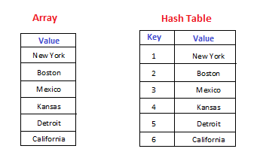
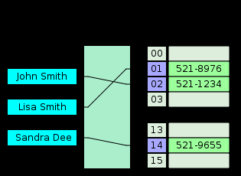
Java HashMap
HashMap is a data structure used to implement an associative array, a structure that can map keys to values. A hash table (map) uses a hash function to compute an index into an array of buckets or slots, from which the correct value can be found.
Notes:
In computer science, an associative array, map, symbol table, or dictionary is an abstract data type composed of a collection of pairs, such that each possible key appears at most once in the collection.

Slide 26
Student marks using HashMap
Key (String) | Value (String)
Alvin | A+
Alan | A
Becca | A-
Sheila | B+

Slide 27
HashMap– Student Marks example
public class StudentMarks {
public static void main(String[] args) {
HashMap<String,String> studentGrades =
new HashMap<String,String>();
//Add Key/Value pairs
studentGrades.put("Alvin", "A+");
studentGrades.put("Alan", "A");
studentGrades.put("Becca", "A-");
studentGrades.put("Sheila", "B+");
//find element using key
System.out.println("Becca's Marks:"+studentGrades.get("Becca"));
//remove element
studentGrades.remove("Becca");
//Iterate over HashMap
for(String key: studentGrades.keySet()){
System.out.println(key +" :: "+ studentGrades.get(key));
}}}

Slide 28
Student marks using HashMap
Key (String) | Value (String)
Alvin | A+
Alan | A
Becca | A-
Sheila | B+
Output
Becca's Marks:: A- Alan :: A Sheila :: B+ Alvin :: A+

Slide 29
HashMap Example2 (skip)
Key (String) | Value (ArrayList<Student>)
ITMB | [hannah,21] [jack,22] [owen,23]
Comp Sci | [john,11] [matt,12] [chris,13]
Games Tech | [richard,31] [dave,32]

Slide 30
HashMap Example2 (skip)
public class Student {
private String name;
private String regNumber;
public Student(String name, String regNumber) {
this.name = name;
this.regNumber = regNumber;
}
@Override
public String toString() {
return "Student{" + "name=" + name + ",
regNumber=" + regNumber +"}";
}
}

Slide 31
HashMap Example (skip)
public class CSCTDept {
//key is award name,
//and the value is a list of students on that award.
private HashMap<String, ArrayList<Student>> allStudents;
public CSCTDept() {
allStudents = new HashMap<String, ArrayList<Student>>();
}
public HashMap getAllStudents() {
return allStudents;
}
… continue from next page …

Slide 32
HashMap Example (Skip)
public void addNewAward(String aName) {
allStudents.put(aName, new ArrayList<Student>());
}
public String getStudentListByAward(String aName) {
return (allStudents.get(aName)).toString();
}
public void addStudentToAward(String sName,
String sReg, String aName) {
(allStudents.get(aName)).add(new Student(sName, sReg));
}
… continue from next page …

Slide 33
HashMap Example -skip
public static void main(String[] args) {
CSCTDept dept = new CSCTDept();
//enter some test data
dept.addNewAward("Comp Sci");
dept.addNewAward("ITMB");
dept.addNewAward("Games Tech");
dept.addStudentToAward("john", "11", "Comp Sci");
dept.addStudentToAward("matt", "12", "Comp Sci");
dept.addStudentToAward("chris", "13", "Comp Sci");
dept.addStudentToAward("hannah", "21", "ITMB");
dept.addStudentToAward("jack", "22", "ITMB");
dept.addStudentToAward("owen", "23", "ITMB");
dept.addStudentToAward("richard", "31", "Games Tech");
dept.addStudentToAward("dave", "32", "Games Tech");
… continue from next page …

Slide 34
HashMap Example -skip
HashMap<String, ArrayList<Student>> all =
dept.getAllStudents();
//list all students in the department
for (ArrayList<Student> award : all.values()) {
System.out.println(award);
}
//list students on a particular award System.out.println(
dept.getStudentListByAward("Comp Sci"));
}
}

Slide 35
HashMap Example2 output -skip
Key (String) | Value (ArrayList<Student>)
ITMB | [hannal,21] [jack,22] [owen,23]
Comp Sci | [john,11] [matt,12] [chris,13]
Games Tech | [richard,31] [dave,32]
Output
[Student{ name=john,regNumber=11}, Student{ name=matt,regNumber=12}, Student{ name=chris,regNumber=13}] [Student{ name=hannah,regNumber=21}, Student{ name=jack,regNumber=22}, Student{ name=owen,regNumber=23}] [Student{ name=richard,regNumber=31}, Student{ name=dave,regNumber=32}] Students on Comp Sci: [Student{ name=john,regNumber=11}, Student{ name=matt,regNumber=12}, Student{ name=chris,regNumber=13}]

Slide 36
Questions?

